Slide 2

Topics
Introduction to Recursion
Problem Solving with Recursion
Examples of Recursive Algorithms

Slide 3
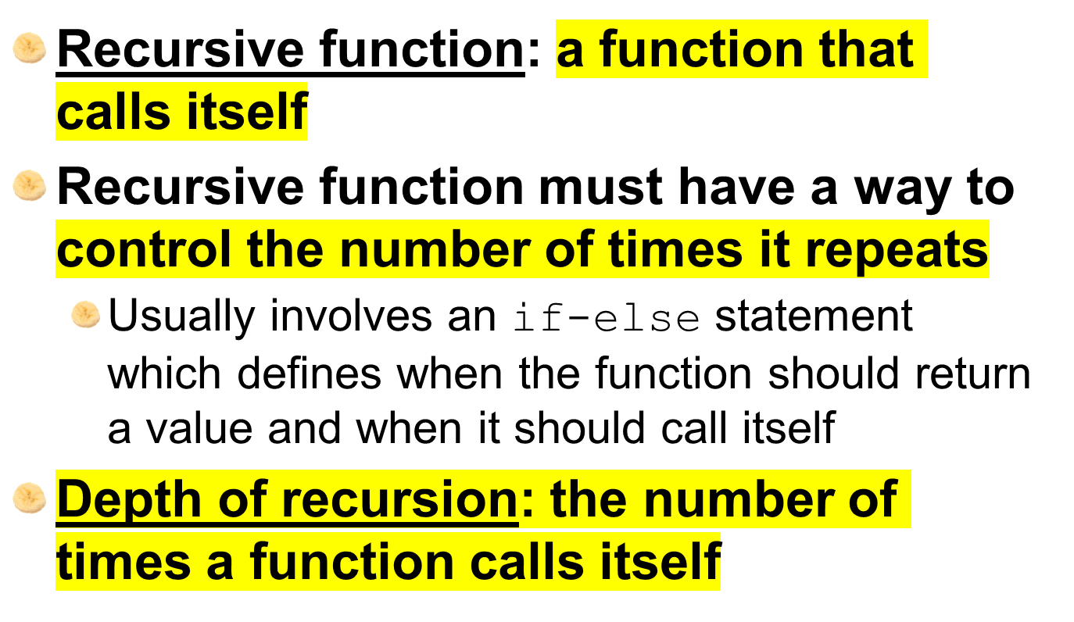
Introduction to Recursion

Slide 4
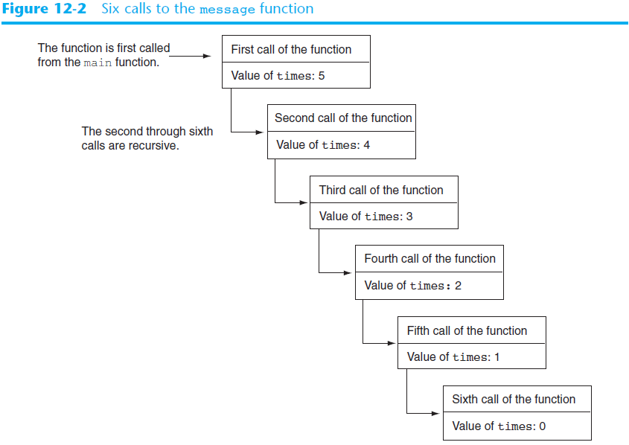

Slide 5
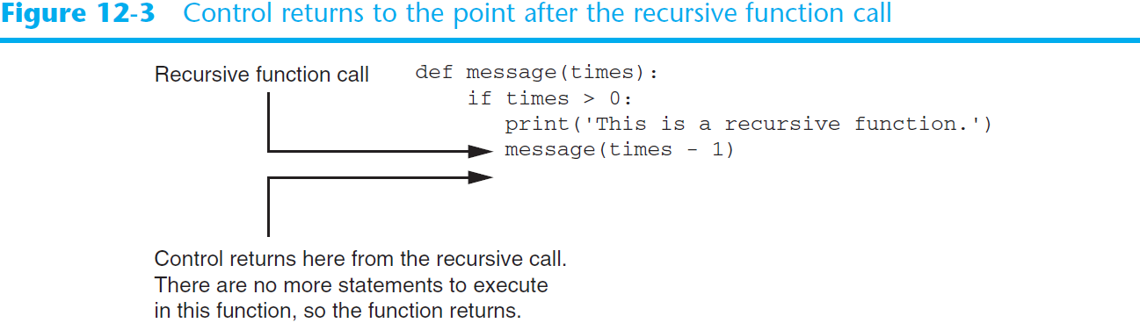
Introduction to Recursion (cont’d.)

Slide 6
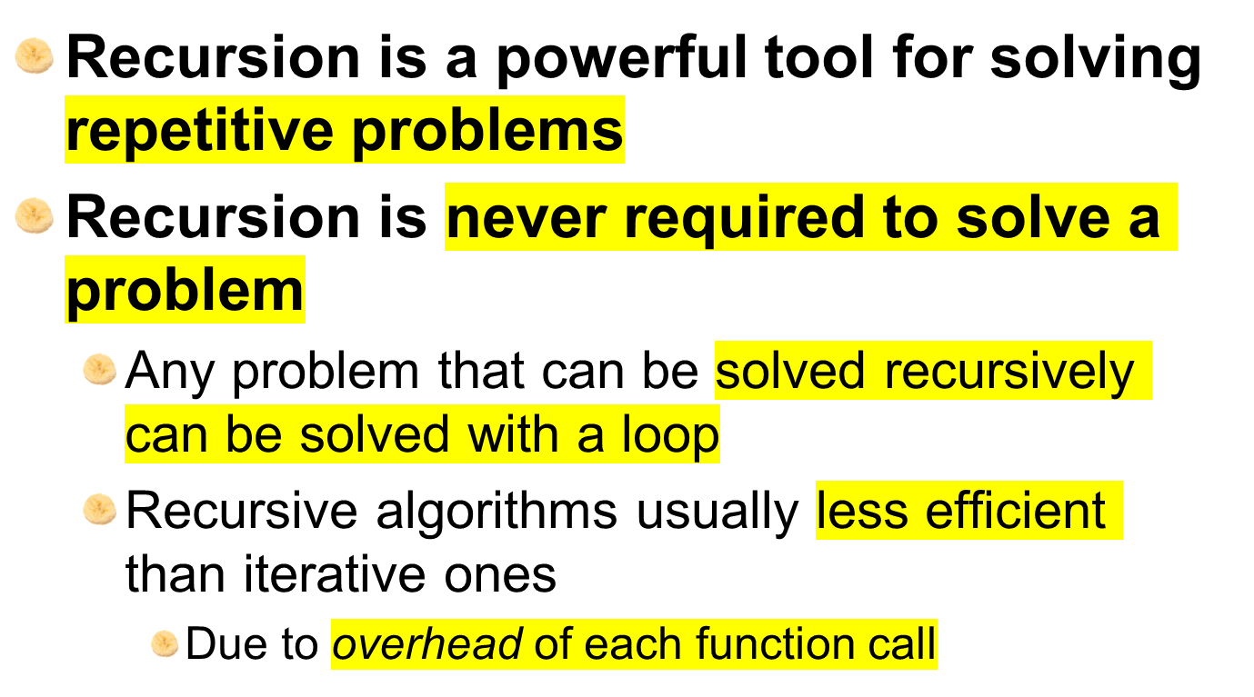
Problem Solving with Recursion

Slide 7
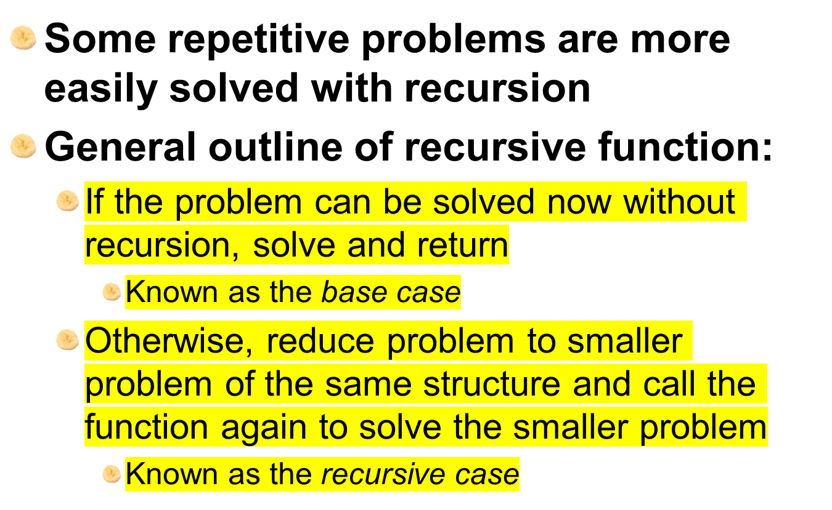
Problem Solving with Recursion (cont’d.)

Slide 8
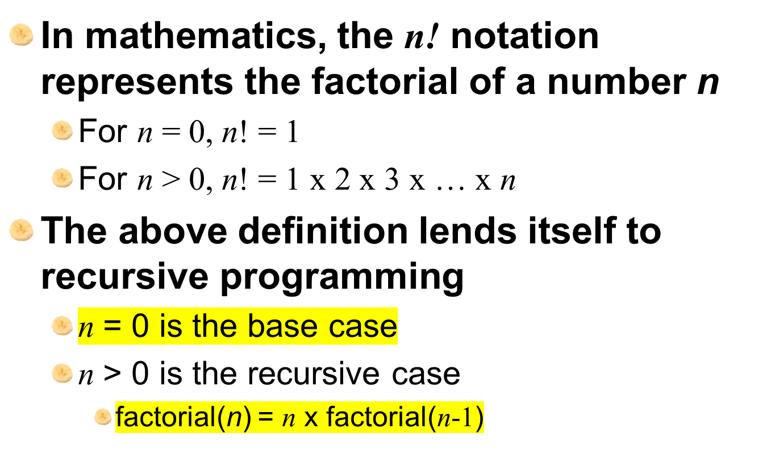
Using Recursion to Calculate the Factorial of a Number

Slide 9
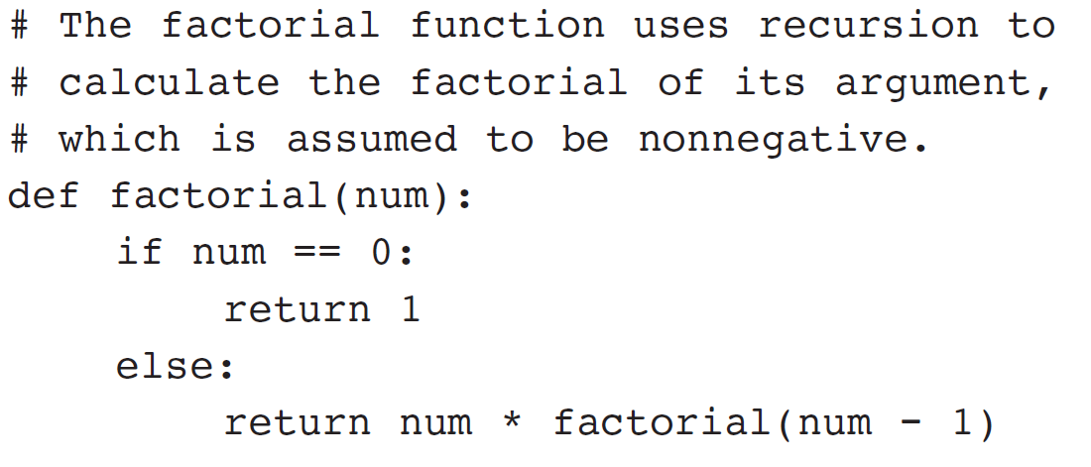
Using Recursion (cont’d.)

Slide 10
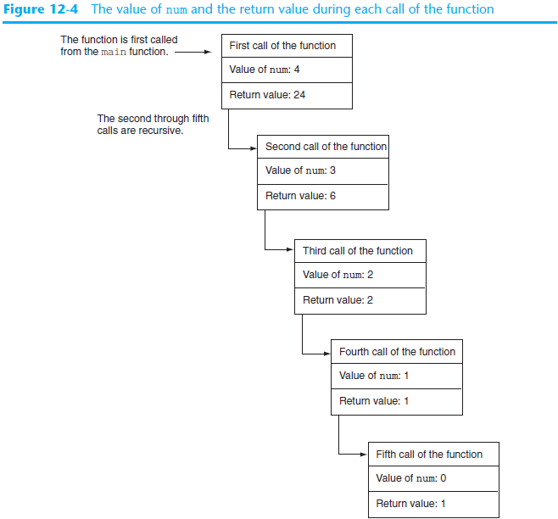

Slide 11
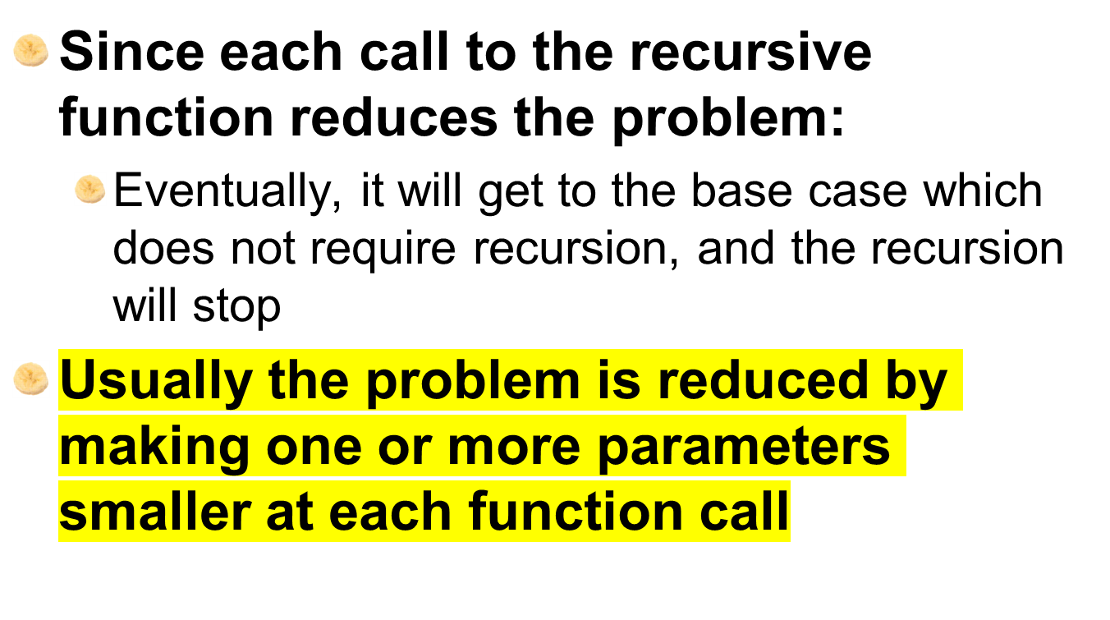
Using Recursion (cont’d.)

Slide 12
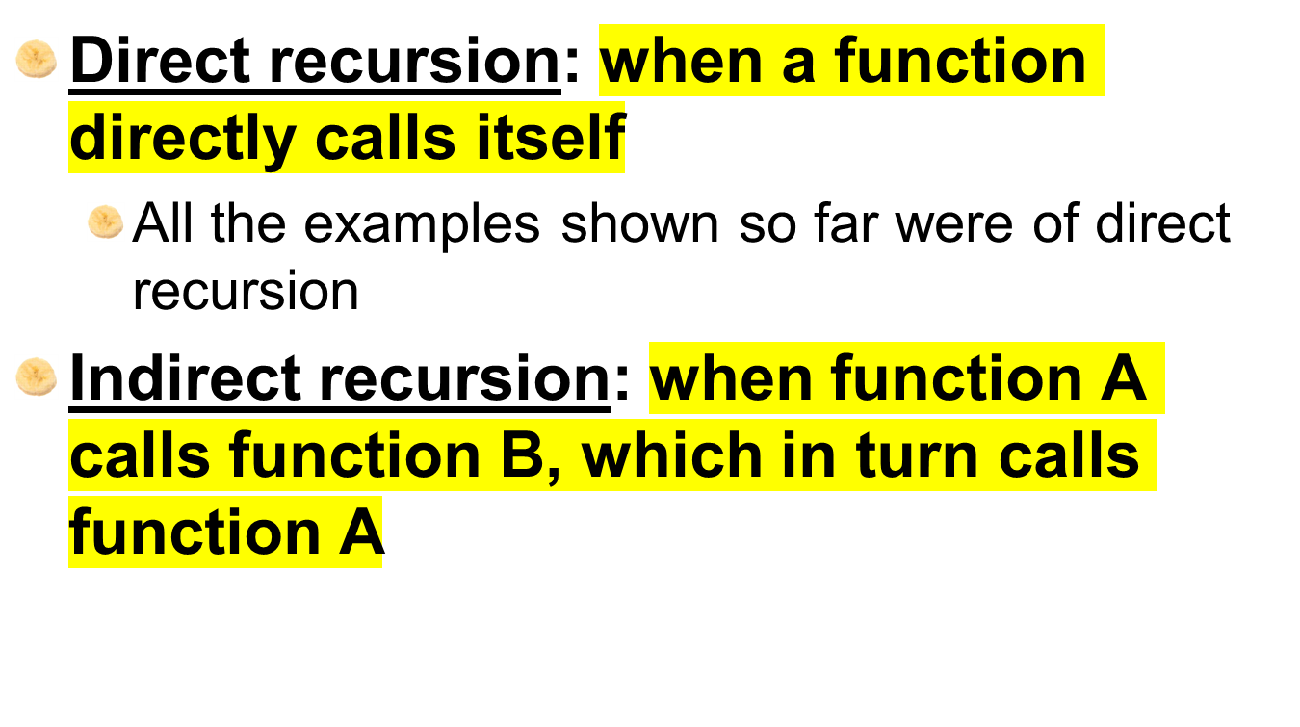
Direct and Indirect Recursion

Slide 13
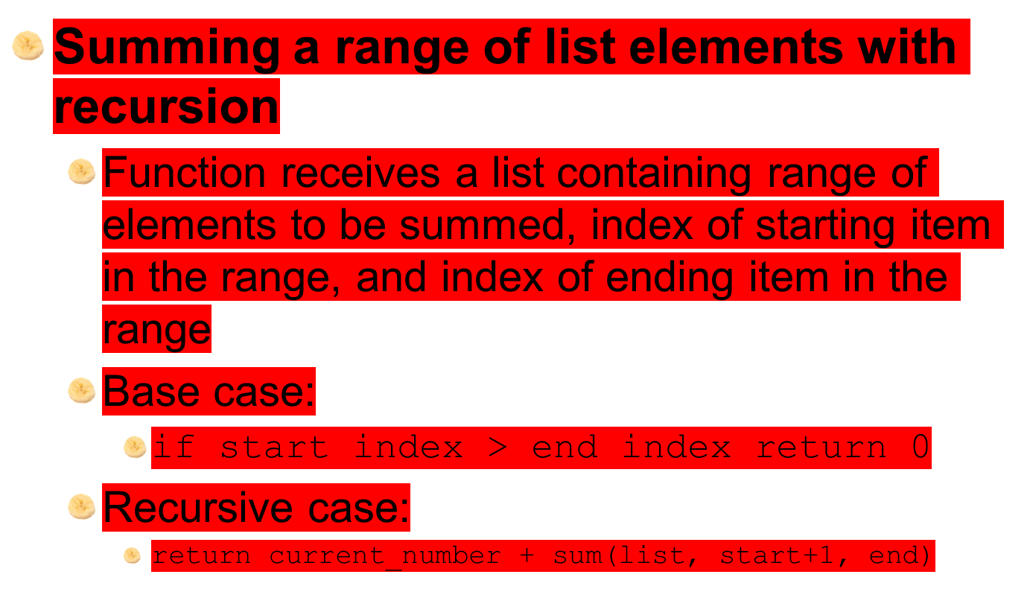
Examples of Recursive Algorithms

Slide 14
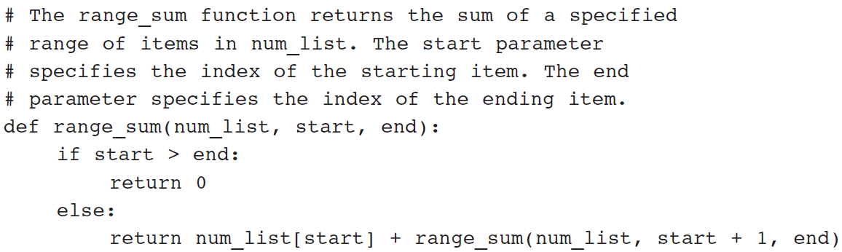
Examples of Recursive Algorithms (cont’d.)

Slide 15
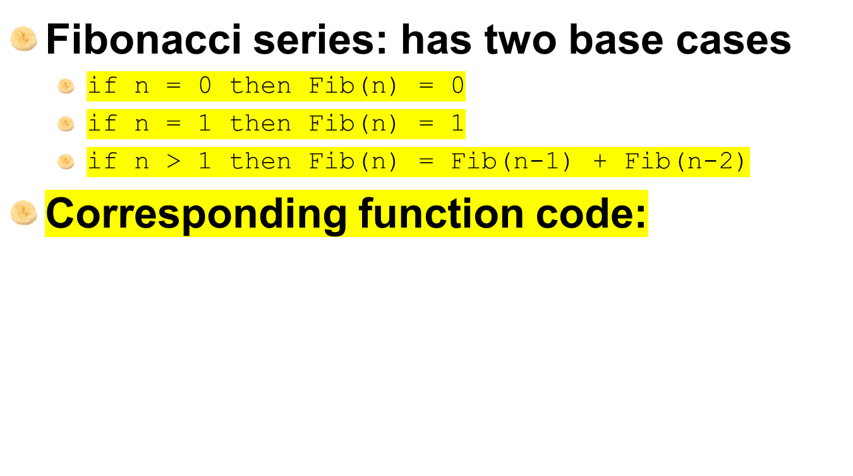
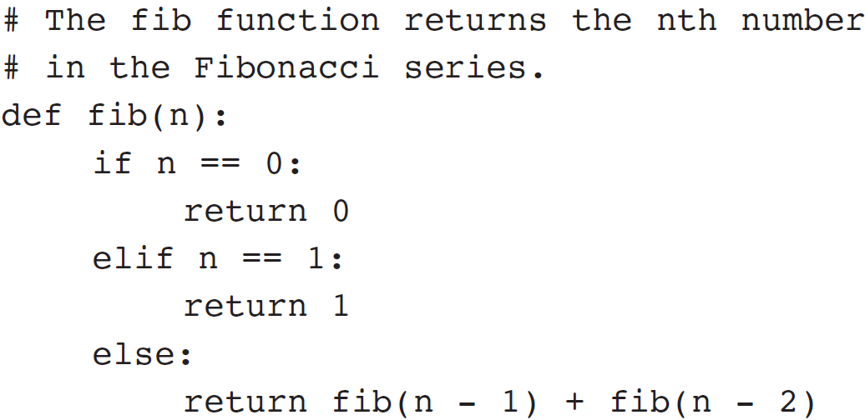
The Fibonacci Series

Slide 16
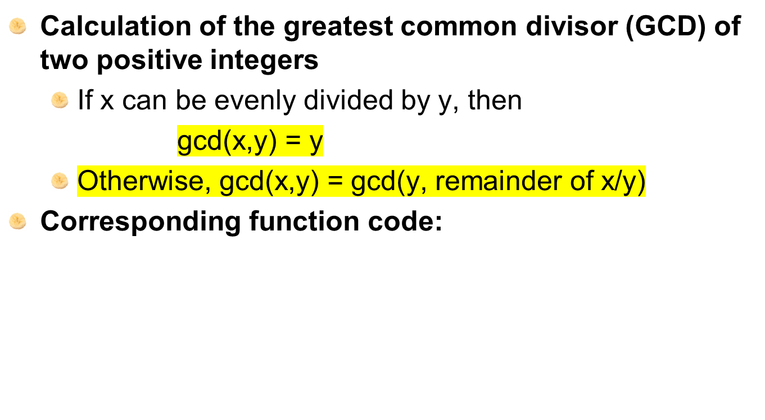
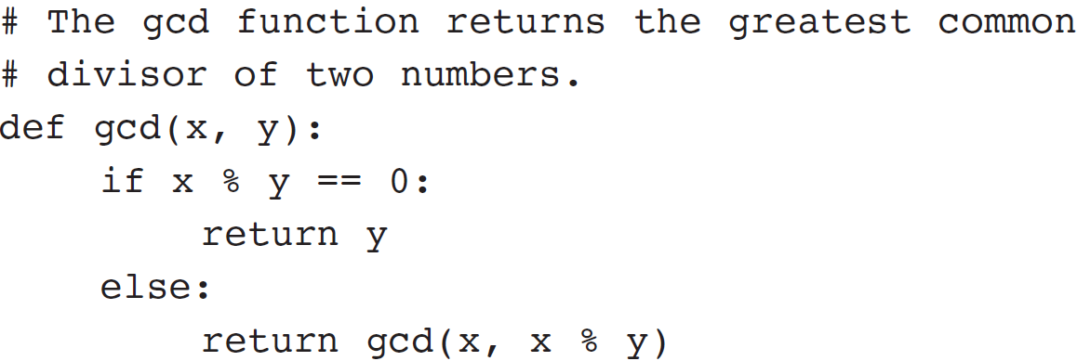
Finding the Greatest Common Divisor

Slide 17
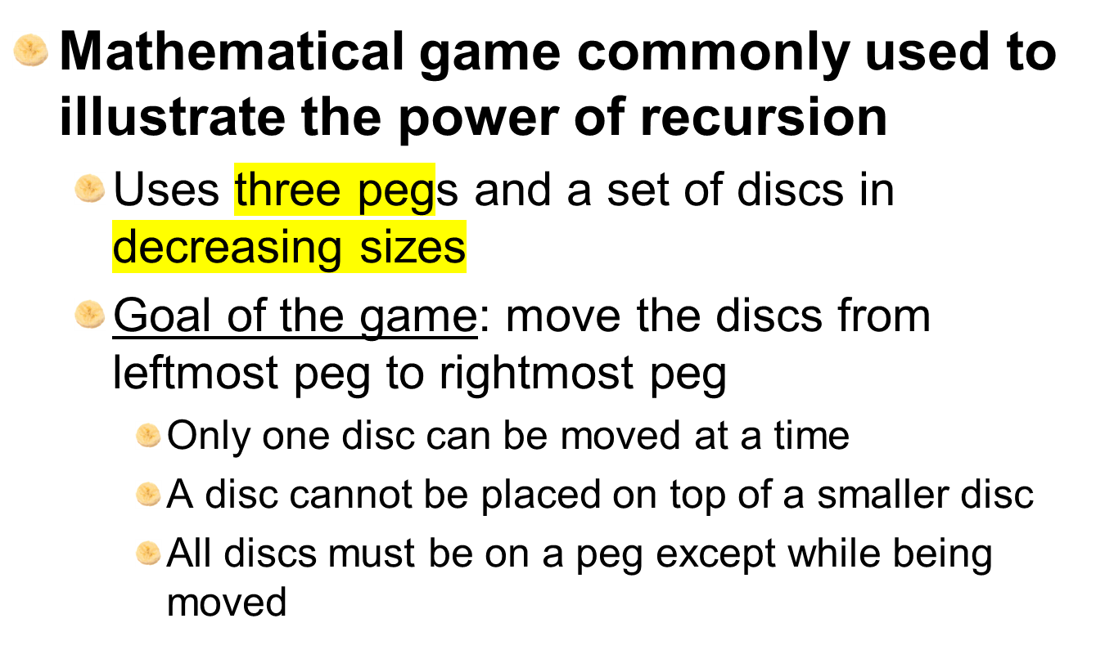
The Towers of Hanoi

Slide 18
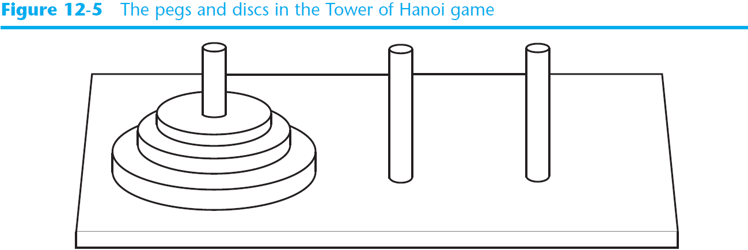
The Towers of Hanoi (cont’d.)

Slide 19
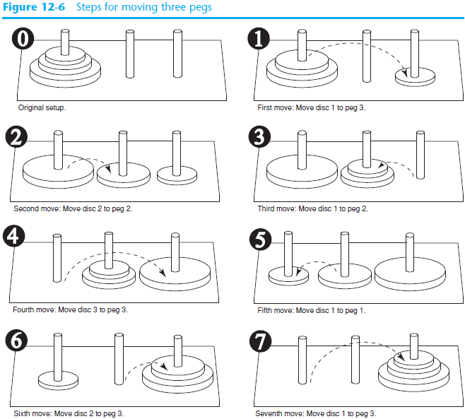

Slide 20
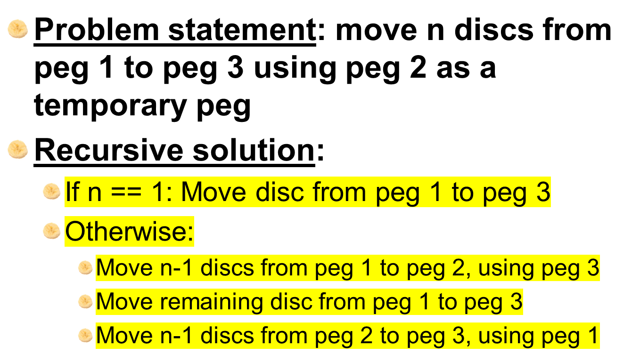
The Towers of Hanoi (cont’d)

Slide 21
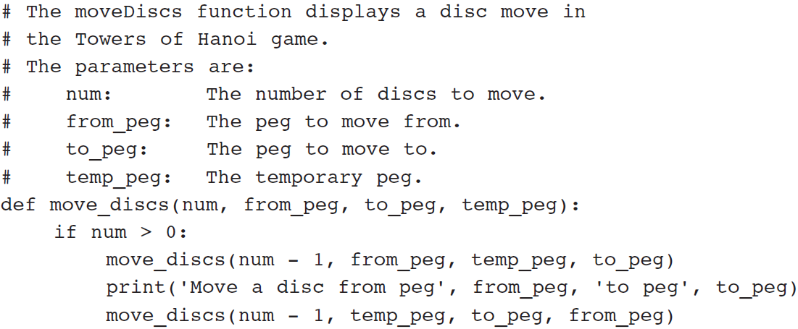
The Towers of Hanoi (cont’d.)

Slide 22
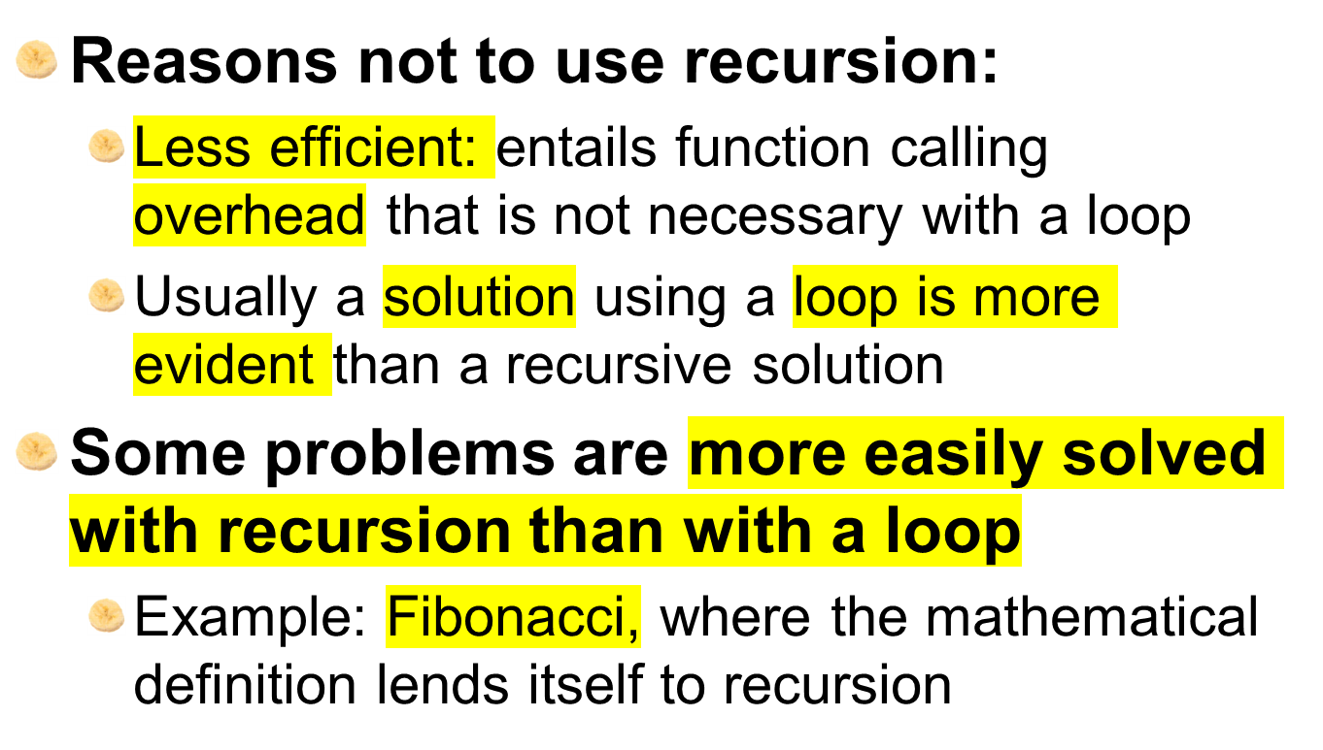
Recursion versus Looping

Slide 23
Summary
This chapter covered:
  Definition of recursion
  The importance of the base case
  The recursive case as reducing the problem size
  Direct and indirect recursion
  Examples of recursive algorithms
  Recursion versus looping

